Slide 1

iot based rain detection system
Created By Suman Purkait | Ranadeep Pain | Rounak Banerjee | Rabisha Jaiswal | NSEC

Slide 2
What is Rain Detection System ? A simple Rain Detection System can be easily built by interfacing an Arduino with Rain Sensor. The sensor will detect any rainfall falling on it and the Arduino board will sense it and can perform required actions. A system like this can be used in many different fields, such as agriculture and automobile fields. Rainfall detection can be used to automatically regulate the Irrigation process. Also, continuous rainfall data can help farmers use this smart system to automatically water the crop only when absolutely required. Similarly, in the automobiles sector windshield wipers can be made fully automatic by using the rain detection system. And the Home Automation Systems can also use rain detection to automatically close windows and adjust room temperature. In this tutorial, we will build a basic rain sensor using Arduino with a buzzer. You can then use this set-up to build anything you wish on top of it. Also, note that the rain sensor module is also referred to as a raindrop sensor or rain gauge sensor or rainwater sensor based on usage, but they all refer to the same sensor used in this project and they all work on the same principle.
Notes:
This is the question that your experiment answers

Slide 3
Project Overview
In this project we'll see how to Interface raindrop sensor to NodeMcu and get alarm whenever the rain intensity crosses some threshold. It can be used as a switch when raindrop falls through the raining board and also for measuring rainfall intensity. The module features, a rain board and the control board that is separate for more convenience, power indicator LED and an adjustable sensitivity though a potentiometer.
Raindrop sensor is basically a board on which nickel is coated in the form of lines. It works on the principal of resistance. When there is no rain drop on board. Resistance is high so we gets high voltage according to V=IR. When rain drop present it reduces the resistance because water is conductor of electricity and presence of water connects nickel lines in parallel so reduced resistance and reduced voltage drop across it.

Slide 4
PROJECT COMPONENT LIST
Components (detailed list) | Quantity (be specific)
ESP8266 Nodemcu | 1
Rain sensor | 1
LED | 1
Breadboard | 1
Jumper wires | 1

Slide 5
COMPONENTS
ESP8266 Nodemcu
Rain sensor
LED

Slide 6
COMPONENTS
Breadboard
Rain sensor

Slide 7
PROJECT STEPS
Step 1 Firstly, identify all components.
Step 2 Secondly, connect these components.
Step 3 Thirdly, we set up the Thingspeak app. First, go to the Thingspeak website and create a new account using my email address. Then, click the “New channel” button. Next, enter my project name as my like. Then, activate the four fields and name “Rain_level”. After, click the “Save channel” button.
Step 4 Next, the program for this project.
Step 6 Now, go back to the Thingspeak app and click the private view tab.
Notes:
Summarize your research in three to five points.

Slide 8
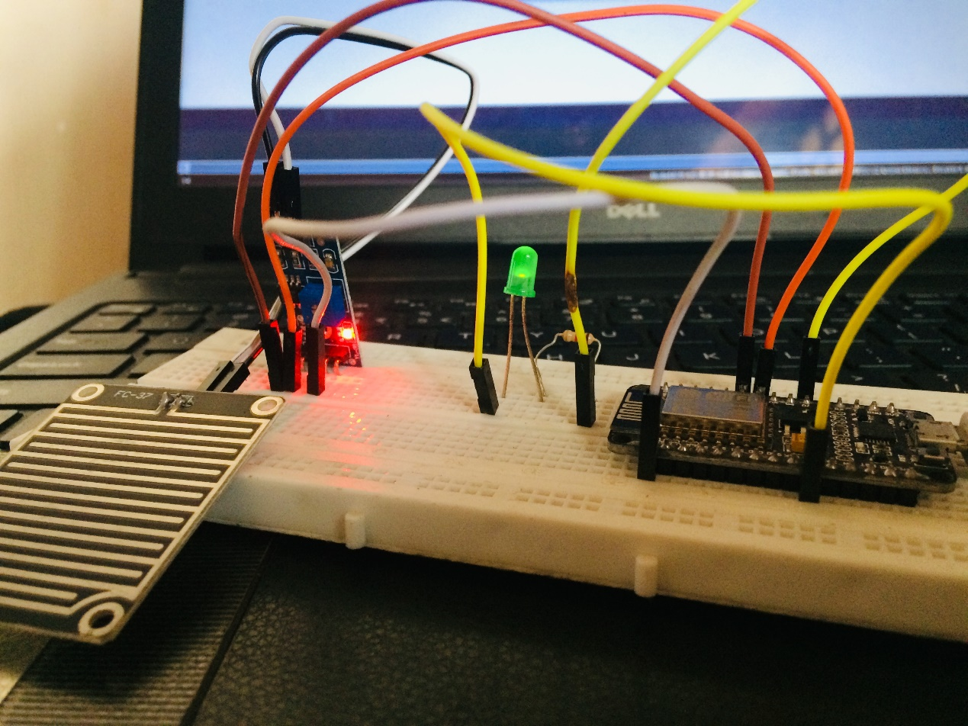
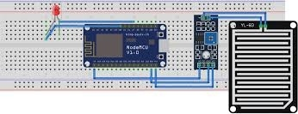
PROJECT CIRCUIT DIAGRAM
Notes:
Summarize your research in three to five points.

Slide 9
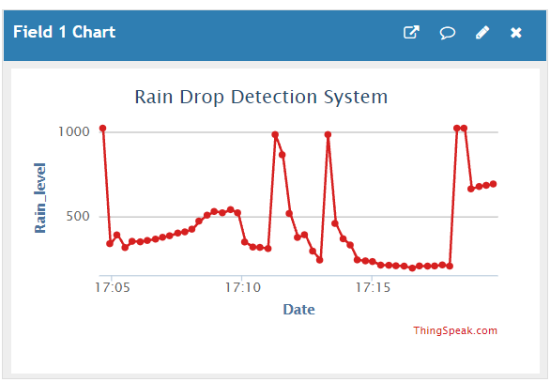
Code Result

Slide 10


PROJECT STEPS
Notes:
Summarize your research in three to five points.

Slide 11
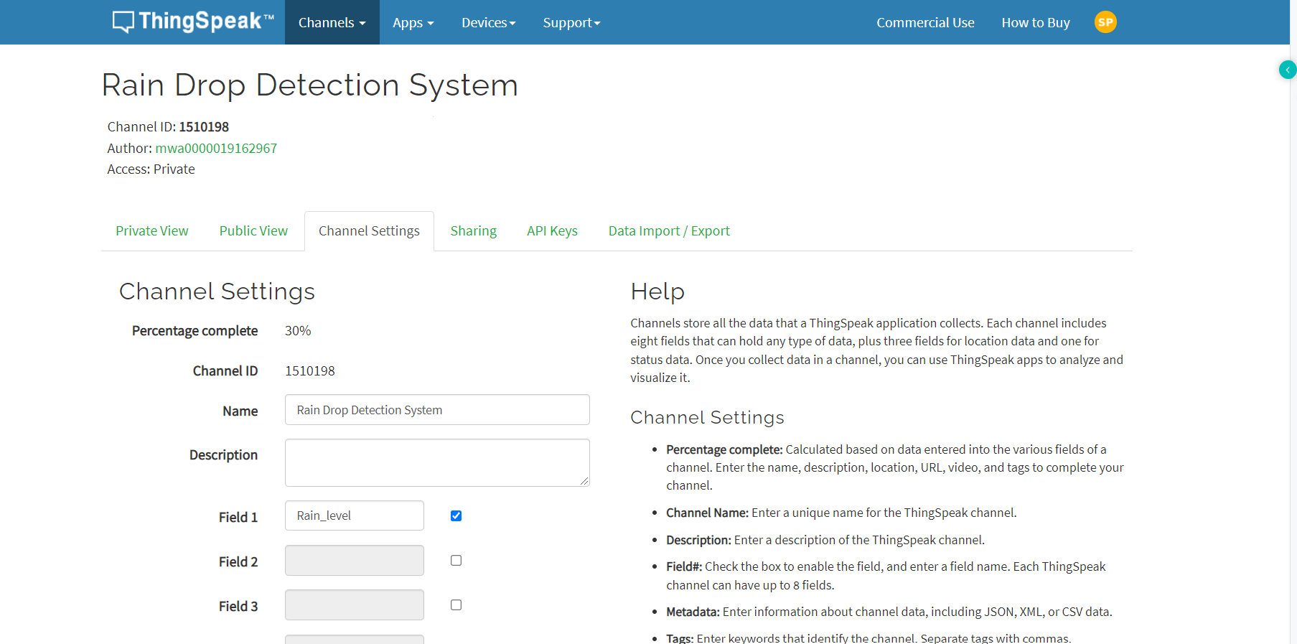
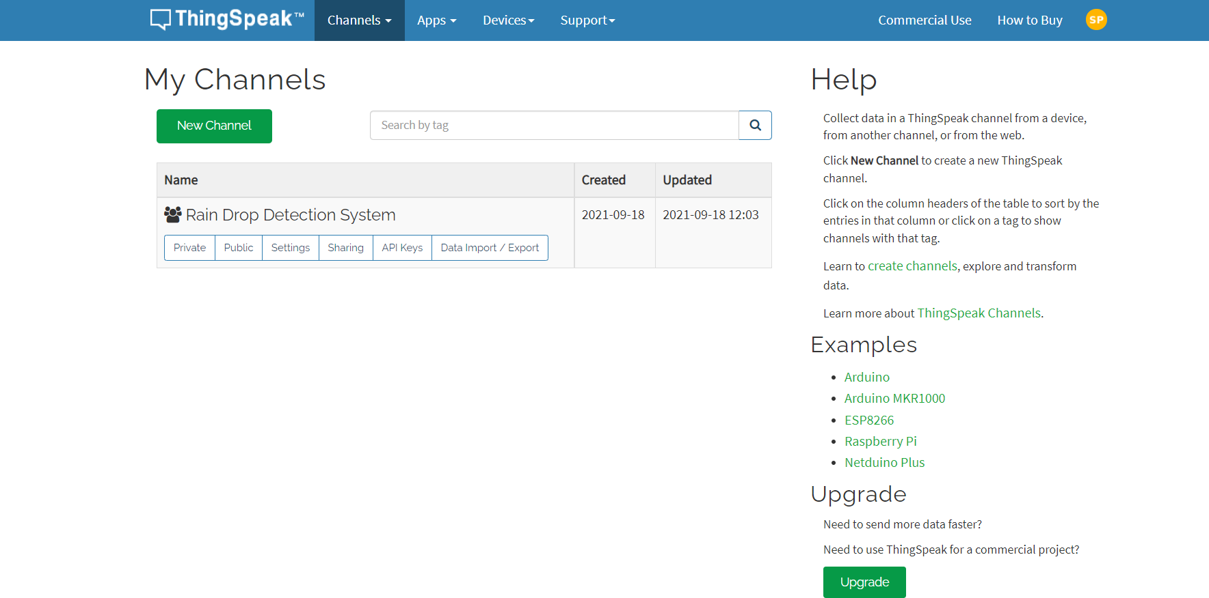
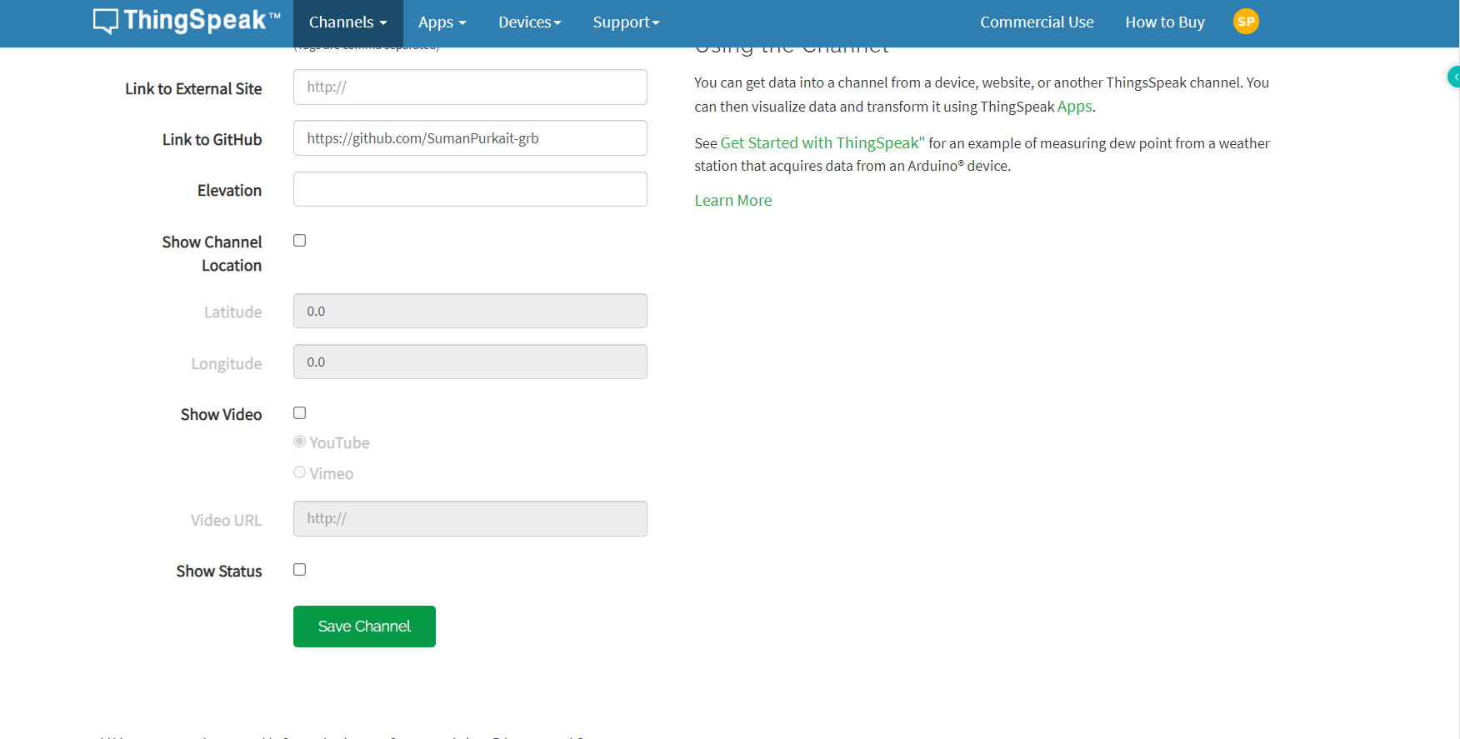
PROJECT STEPS
Notes:
Summarize your research in three to five points.

Slide 12
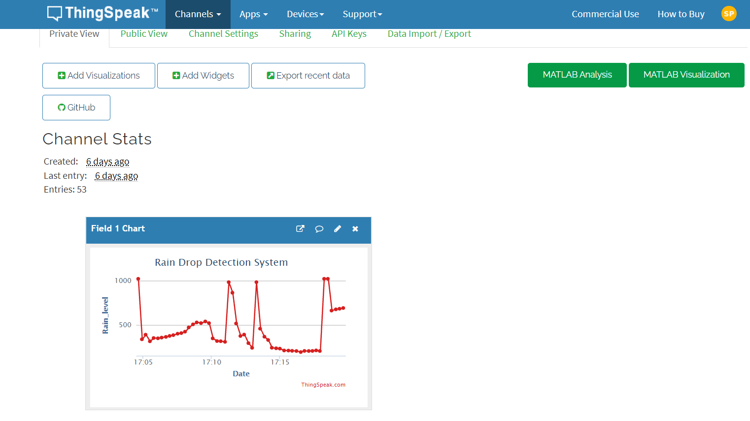
Final Result
Notes:
Summarize your research in three to five points.

Slide 13
Conclusion
This project proposed rainfall detection system that has rainfall sensors and Arduino as controlling unit that senses the rain and processes the data to generate the intensity of the rainfall for the required measures to be taken in advance. The system is devised to calculate intensity of rainfall and the consequent response taken by the authorities to regulate the flow of water. Thingspeak and Wi-Fi connected to a cloud server is used for local authority.

Slide 14
Thank You…..

